Slide 1

Analyze Customers Reviews Based on Ratings And Recommendation
By Omnia Hosny

Slide 2
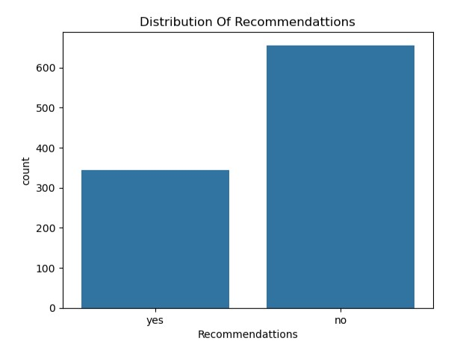
33.5% of customers gave rating 1 for BA
33.4 % Not Recommended BA for other
so why?

Slide 3
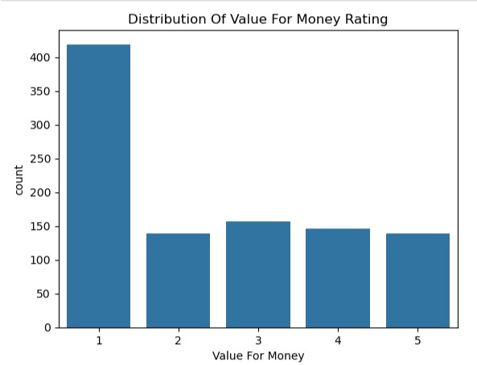
After Analysis:
We get 41.9% of customers gave rating 1 in value for money
Against 13.9% gave 5
So the customer not satisfied about service for money

Slide 4
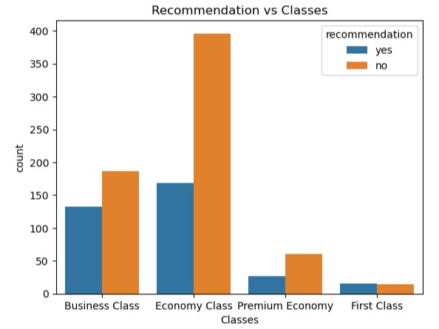
After Analysis:
We get 70.5% of Economy class not recommend BA for other

Slide 5
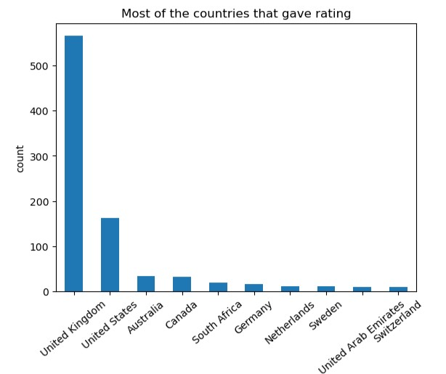
After Analysis:
Most countries that gave reviews UK

Slide 6
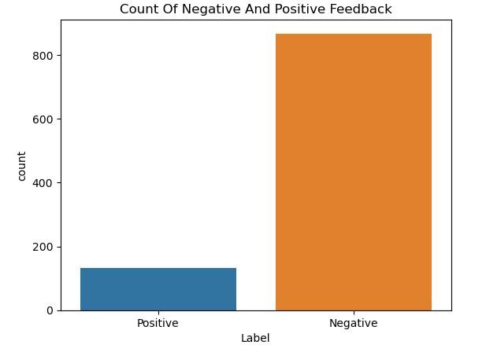
After Analysis Text Reviews:
86.7% of customers gave BA Negative Feedback.

